Slide 1

Factor Data+AI Day
Homegrown data management: Sustaining Data Quality Across System Migrations
Casey Morter
Director, Business Analytics
JLL
Tuesday | September 10
Collins Square, Melbourne
Notes:
"Hi my name is Casey, and I help teams get the most out of their data and supporting systems.
After this presentation, I hope you get an idea of how to prepare for a hassle-free system migration, with minimal impact to your customers.

Slide 2

Across system migrations?
A big event like a system migration is a great catalyst for a data quality effort, but any excuse will do.
Hopefully, this talk will provide some quick and easy techniques to get started with data quality management.
Want to break down the ‘toolbox fallacy’ - start simple, asap.
Will not be discussing specific platforms or technologies and will keep technical details light.
(Come have a chat later if you would like to talk shop)

Slide 3


Data Quality in context
Data
Process
Outcome
If your shiny new target system facilitates GenAI or ML, ensuring data represents business activity accurately is key to realising success.
Integrating data quality processes into daily operations is the most effective.
Getting checks as close to the data producers as possible pays massive dividends.

Slide 4
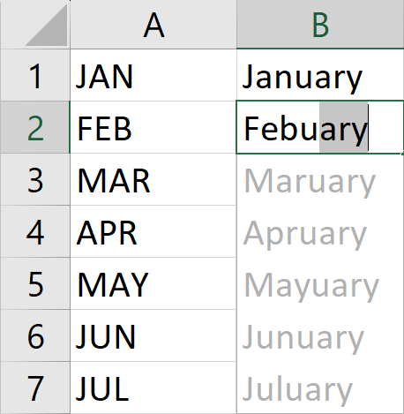
Tools?
Let’s start with everyone’s Favorite tool – Excel.
Why excel you may ask?

Slide 5


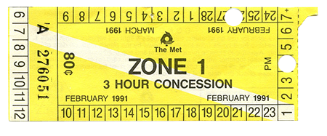
Accessibility

Slide 6
Where to focus?
Looking at dashboards and reports across 4 major accounts in 2022, we found that data products drawing from multiple streams were third most popular.
Combined reporting is great in bringing more insightful data to the business but requires strong referential integrity.
We decided to focus on fields needed to map systems together to provide a full picture of, in our case, a building.

Slide 7
Where to start?
Explicit Knowledge
Data Documentation System processes
10%
90%
Tacit knowledge emerges as part of regular business processes and can be hard to formalise.
We found it was best to identify high impact areas so the improvements would have a quick payback.
Capturing knowledge as a first step.
Codify business knowledge wherever possible.
Implicit Knowledge
Experience Competence Business moving faster than tooling

Slide 8
Capturing ‘Facts’
A ‘fact register’ is a great place to start and is super helpful when investigating a new dataset or process.
Date | Contributor | Fact | System | Field(s) | Status
1/9/2024 | Casey | OrderID is unique | Sales | OrderID | Depreciated
2/9/2024 | Geoff | OrderID is unique to a store | Sales | OrderID, StoreID | Active
2/9/2024 | Geoff | StoreID is 12 characters | Supply | StoreID | Active
3/9/2024 | Emily | StoreID must be populated for a store to take orders | Sales | StoreID | Active
Coverage can always be improved, and assumptions by the team also need to be listed.

Slide 9
Investigation
Fact
Assumption
Fact
OrderID is unique to StoreID
Assumption
Investigation
A duplicate OrderID is not valid
Investigation
Decision
30 Duplicate OrderIDs found at Store ‘YOL01’
Decision
Ignore these OrderIDs be ignored in analysis & reporting?
System Update / Change

Slide 10
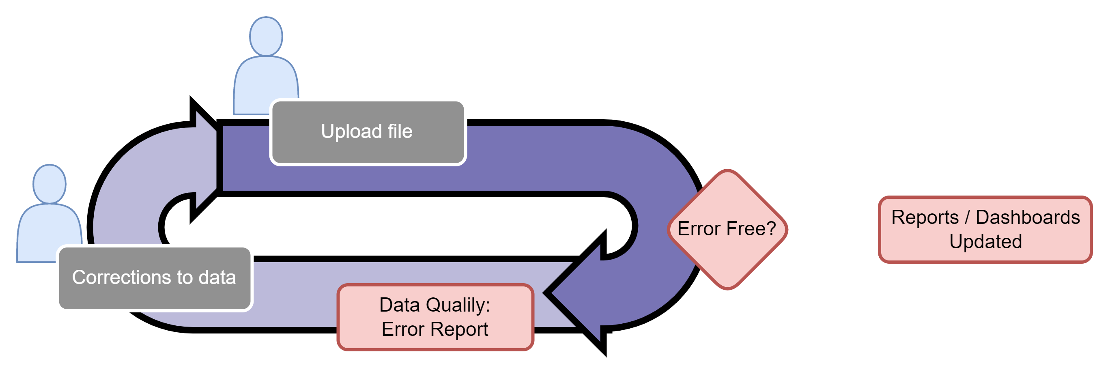

Bringing ‘facts’ to life
Once a set of ‘facts’ have been refined into business rules, these can be codified into a workflow for the data producers.

Slide 11
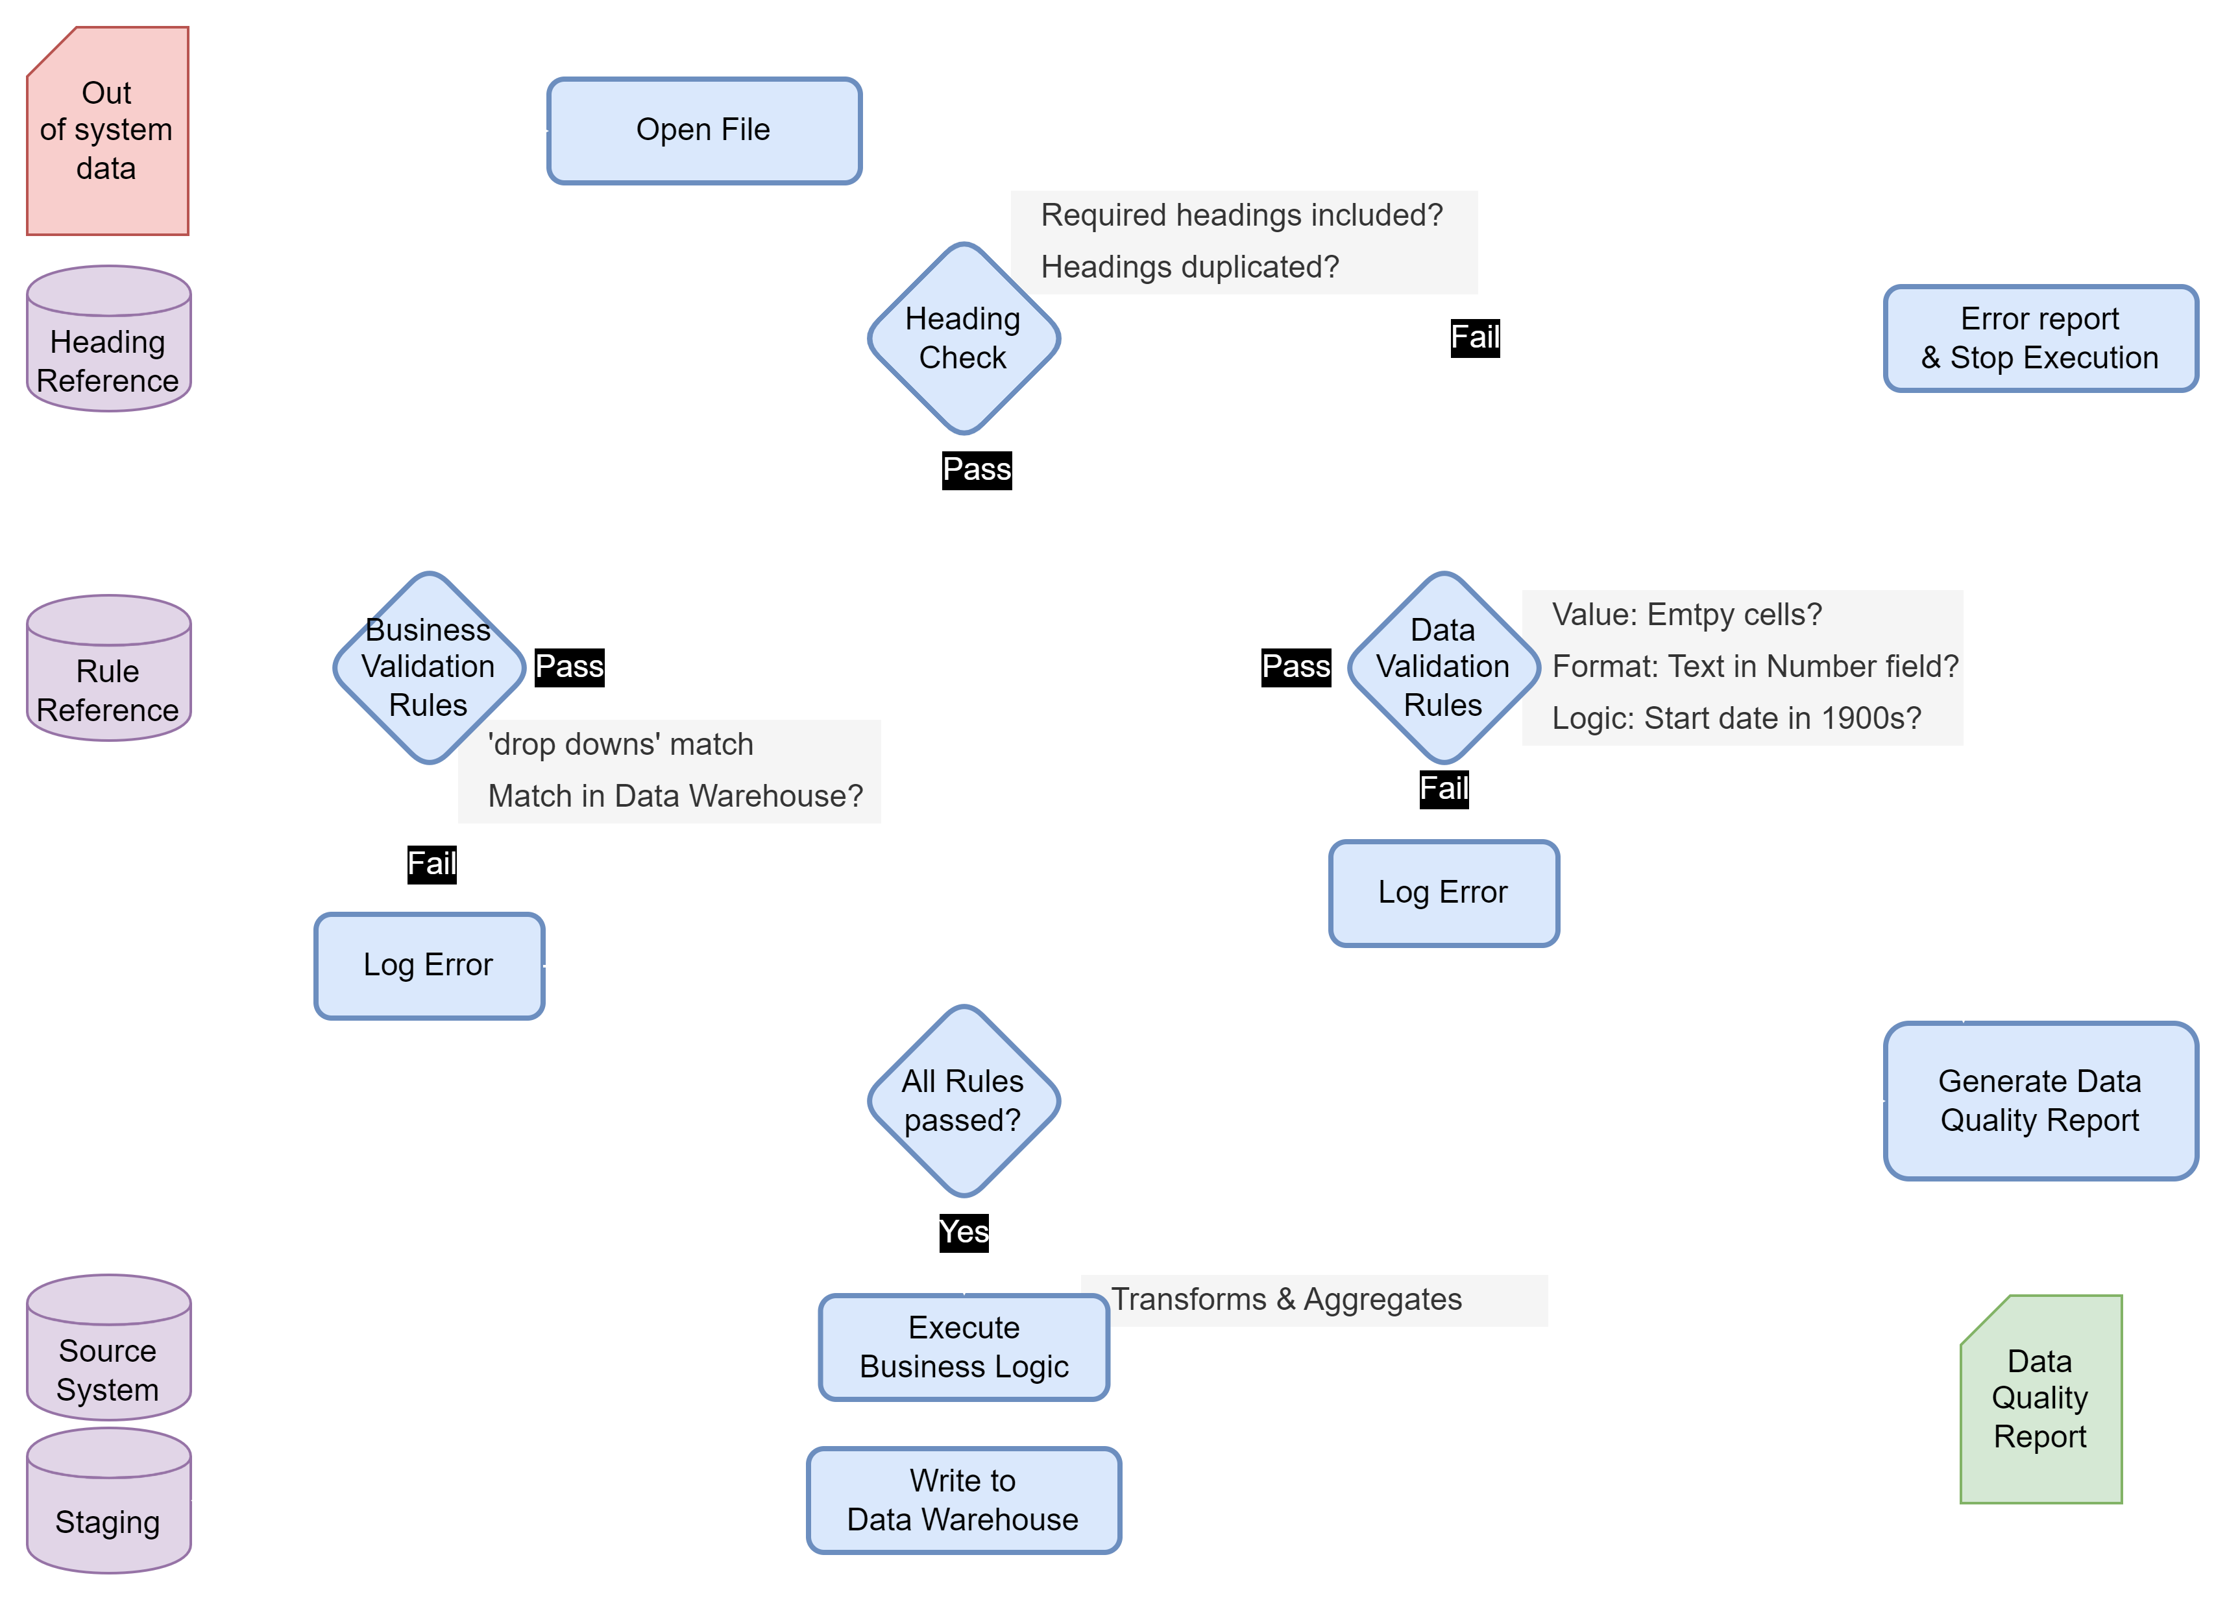

Enterprise
Reporting
Interface
System

Slide 12
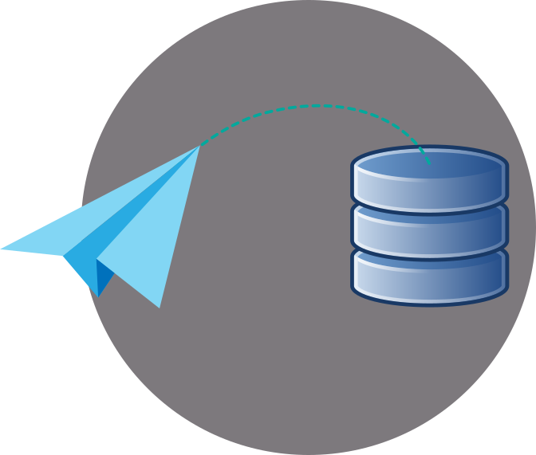
Interface
Assurance

Slide 13
Sharing results
RunLog
RunNumber
WorkflowName
ErrorLog
RunNumber
ErrorText
ErrorField
RefTable
WorkflowName
ReferenceData
Field
RunLogMeta
RunNumber
AggregateData
Once a few of these ‘Interface Assurance’ tools are deployed, logging and trending errors is interesting.
We used a common schema for errors to enable us to trend multiple workflows for a given account.
Type | Example | Execution
Heading Error | Missing header, Duplicate header | Halting
Format Error | Date listed as 'TBC' | Warning / Ignore row / reject entire dataset
Value Error | Value missing / unrecognised format
Logic Error | Duplicate record, rule violation

Slide 14
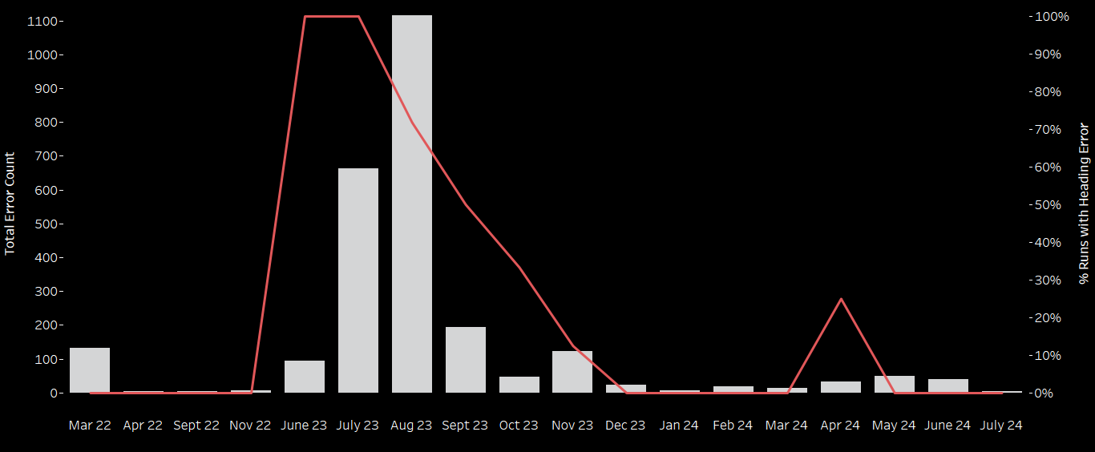
Sharing results

Slide 15
Final thoughts…
Start small, start with the business, find any excuse and start.
Be a trusted business partner not the data police.
Share success and celebrate the team.

Slide 16
Thank you

